Slide 1
BASIC FEATURES OF
INDIAN CONSTITUTION
Presented
by
Ms. Khushbu Prasad
Assistant Professor cum Programme Leader, Amity Law School

Slide 2
INTRODUCTION
The Constitution of India was drafted by the Constituent Assembly. The Constituent Assembly held its first sitting on the 9th December, 1946. It reassembled on the 14th August, 1947, as the sovereign Constituent Assembly for the Dominion of India.
Constitution of India is the supreme law of India. It lays down the framework defining fundamental political principles, establishing the structure, procedures, powers and duties, of the government and spells out the fundamental rights, directive principles and duties of citizens. Passed by the Constituent Assembly on 26 November 1949, it came into effect on 26 January 1950.

Slide 3
The Constitution of every country has certain
special features
because economic
the historical and political
background, social,
conditions influence the making of the
constitution. All these factors have contributed in the making of the Constitution of India.

Slide 4
CONSTITUTION: MEANING
A constitution means a document having a special legal sanctity which sets out the framework and principal functions of the government.
It gives idea about the basic structure of the political system under which its people are to be governed.
It defines the powers of the main organs of the state, demarcates their responsibilities and regulates their relationship with each other and with the people.
It can also be termed as the Fundamental Law of a country which reflects people’s faith and aspirations.

Slide 5
Role of Constitution in relationship between Government and its people:-
CONSTITUTION
GOVERNMENT
THE PEOPLE
LEGISLATIVE
Makes Laws
JUDICIARY
Interprets Laws
EXECUTIVE
Enforces Laws

Slide 6
SOURCES OF INDIAN CONSTITUTION
SOURCES | FEATURES BORROWED
1.Government of India Act,1935 | Federal scheme, office of governor, judiciary, emergency provisions
2. UK | Single citizenship, rule of law, parliamentary government, bicameralism, cabinet system
3. US | FR, judicial review, independence of judiciary, removal of SC and HC judges, impeachment of president, post of vice-president

Slide 7
4. CANADA | Federation with strong centre, residuary power of centre, advisory jurisdiction of SC, appointment of state governor
5.Ireland | Directive principles of State Policy, nomination of members to Rajyasabha, method of election of president
6.Australia | Concurrent List, Trade and Commerce, joint sitting of houses of parliament
7. Germany | Suspension of Fundamental rights during emergency
8. USSR | Fundamental Duties

Slide 8
9. France | Republic and ideals of liberty, equality and fraternity in the preamble
10.South Africa | Amendment of Constitution
11. Japan | Procedure established by law

Slide 9
Salient Features of Indian Constitution
1. Preamble:
The Preamble, the preface to the constitution, describes the source nature, ideology, goals and objectives of the constitution. It describes India as a sovereign socialist, secular, democratic republic and underlines the-national objective of social just: economic justice and political justice as well as fraternity.
2.Written Constitution:
There are two types of constitutions in the world. Most of the constitutions are written. The first modern written constitution was the American constitution. On the other hand, the British constitution is unwritten. It consists of customs and conventions which have grown over the years. In India, we have a written constitution. The framers of our constitution tried to put everything in black and white.
3.Longest Constitution:
The Constitution of India is the longest one in the world. Originally it had 395 Articles and 8 schedules. During the period since 1950 a few Articles have been deleted, but many more have been added through amendments.

Slide 10
4. Parliamentary Democracy:
In India, there is a parliamentary form of govern The majority party in the Lower House (Lok Sabha) forms government. The Council Ministers is responsible to the Lok Sabha. The Cabinet is the real executive head. In Presidential form of government, the President is the executive head. In India, the President is only the nominal head.
5. Role of Conventions:
Though India has a very detailed constitution, there is some scope for conventions to influence its functioning. On some vital issues constitution is silent and one has to depend upon well-established parliament conventions on such occasions.
6. Federal Government with Unitary Bias:
India is a federation, although word 'federation' does not find a place in the whole text of the Indian Constitution. The elements of federation are present in the Indian Constitution. It is a written and rigid constitution.
7. Fundamental Rights:
The Fundamental Rights are guaranteed to the individuals by our constitution. These are enumerated in Pail III of the constitution. These rights are fundamental because they are basic to the moral and spiritual development of the individual and these rights cannot be easily abridged by the parliament .

Slide 11
8.Partly Rigid, Partly Flexible:
Whether a constitution is rigid or flexible depends on the nature of amendment. If the constitutional laws and ordinary laws are amended separate ways, it is a rigid constitution. On the contrary, in a flexible constitution constitutional laws and ordinary laws are amended in the same way.
9. Directive Principles of State Policy:
The Directive Principles of State Policy are enumerated in Part IV of the constitution. They are instructions or directives from the constitution to the state and the government. It is the duty of the government to implement them.
10. An Independent and Integrated Judiciary:
An independent judiciary is a none of any federation. The judiciary in India is independent and impartial. It is an integrated judiciary with the Supreme Court at the apex of the hierarchy. The High Courts stand in its middle, and the lower courts are located at its bottom.
11. Universal Franchise:
Article 326 of the Constitution of India provides universal adult suffrage. The voting age has now come down from 21 to 18. Anybody who has completed 18 years of age is eligible to vote in general elections. This is one of the most revolutionary aspects of Indian democracy.
12. Secularism:
India is a secular state. Although the 42nd Amendment Act, inserted the word 'secular' in the Preamble to the constitution, India has been secularism since independence.

Slide 12
NATURE OF INDIAN CONSTITUTION-FEDERAL OR UNITARY
ESSENTIAL FEATURES OF FEDERALISM
1. Division of Powers:
In a federal government, the powers of administration are divided between the centre and the units. The powers may be distributed in one of the two ways. Either the Constitution states what powers the federal authority shall have and leaves the remainder to the federating units, or it states what powers the federating units shall possess and leaves the remainder to the federal authority.
2. Written Constitution:
A federation must have a written constitution. A federation is a political partnership of various states and consequently there must be a written constitution.
3. Rigid Constitution:
The constitution of a federation should be better rigid so that it could be regarded as a sacred agreement, the spirit of which should not be easily violated. A flexible constitution allows scope to the central government to curtail the autonomy of the federating states.
4. Special Judiciary:
In a federation there are possibilities of constitutional disputes arising between the federal centre and the units or between one unit and another or between the citizens and the government. All these disputes are to be adjudicated in the light of the constitution.

Slide 13
5. Supremacy of the Constitution:
The constitution is the supreme law in a federation. Neither the central government nor the government of the units can go against its spirit.
6. Double Citizenship:
Citizens in a federal state have dual interests and they should be given rights of double citizenship—citizen­ship of the state wherein they are domiciled and citizenship of federal state as a whole.
FEDERAL CHARACTERISTICS IN INDIAN CONSTOTUTION
Supremacy of Constitution
Divisions of powers between union and state governments
Existence of an independent judiciary
Rigid procedure for amendment-sometimes states are also given a say
INDIAN CONSTITUTION- FEDERAL OR QUASI FEDERAL
Prof. Wheare- “Quasi-federal”, almost devolutionary in character; a unitary state with subsidiary federal features rather than a federal state with subsidiary unitary features.
Dr. Ambedkar - both unitary as well as federal according to the requirement of time and circumstances.

Slide 14
WRITTEN CONSTITUTION
The written constitution is the one which you can get in the form of a book and can be read. There are 395 Articles, 12 schedules and it has been divided into 22 parts and till date more than 104 amendments have been made into it. The Constitution, in its current form, consists of a preamble, 22 parts containing 448 articles,
12 schedules, 5 appendices and 108 amendments to date.

Slide 15
DETAILED CONSTITUTION
The Indian Constitution is the longest and the most detailed in the world. A detailed list of Fundamental Rights from article 12-25 is included in chapter 3rd of the constitution. In chapter 4th from article 35-51 a detailed list of directive principles of State Policy is also included which are guidelines of the State in policy making. From article 350-360 the Emergency powers of the President have also been included in it. A detailed description of center-states relations is given in chapter 11 and 12 of it.

Slide 16
Sovereign ,Socialist ,Secular, Democratic, Republic
India has been declared a sovereign, secular, Democratic, Republic through the Preamble of the Constitution of India.
Sovereign State –India is free to formulate its internal and foreign policy and free to maintain relations with any foreign state.
Socialist State- The aim of the state is to establish socialist society which is free from exploitation of man by man and in which social economic and political justice is provided to all.

Slide 17
Secular State- The state has no religion of its own, it does not discriminate against any religion by imposing restrictions upon it
Democratic State -The preamble also declares India to be a democratic state in which the supreme power rests in the hands of the people.
Republic- The President of India is elected for a
fixed term by the indirect vote of the people.

Slide 18
FUNDAMENTAL RIGHTS
Fundamental rights have been included into the Part III of the constitution from Article- 12 to 35
Right to Equality (Article- 14 to 18)
Right to Freedom (Article- 19 to 22)
Right Against Exploitation (Ar. 23 to 24)
Right to Religious Freedom (Ar. 25 to 28)
Cultural and Educational rights (Ar. 29 /30)
Right to Constitution Remedies (Ar- 32)

Slide 19


Slide 20
DEFINITION
Fundamental Rights are essential human rights that are offered to every citizen irrespective of caste, race, creed, place of birth, religion or gender. These are equal to freedoms and these rights are essential for personal good and the society at large.

Slide 21
SIX FUNDAMENTAL RIGHTS
The Right to EQUALITY
The Right to FREEDOM
The Right to Freedom from EXPLOITATION
The Right to FREEDOM OF RELIGION
CULTURAl and EDUCATIONAL Rights
The Right to CONSTITUTIONAL REMEDIES

Slide 22

Right to equality

Slide 23
Right to equality
(i) Equality before Law :- Article 14 of the constitution guarantees that all citizens shall be equally protected by the laws of the country
(ii) Social equality and equal access to public areas:- Article 15 of the constitution states that no person shall be discriminated on the basis of caste, colour, language etc. Every person shall have equal access to public places like public parks, museums, wells, bathing ghats and temples etc. However, the State may make any special provision for women and children.

Slide 24
Right to equality
(iii) Equality in matters of public employment:- Article 16 of the constitution lays down that the State cannot discriminate against anyone in the matters of employment. All citizens can apply for government jobs.
(iv) Abolition of untouchability :- Article 17 of the constitution abolishes the practice of untouchability. Practice of untouchability is an offense and anyone doing so is punishable by law.
(v) Abolition of Titles:- Article 18 of the constitution prohibits the State from conferring any titles. Citizens of India cannot accept titles from a foreign State.

Slide 25
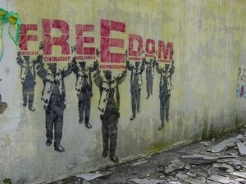
Right to freedom

Slide 26
Right to freedom
(i) Freedom of Speech and expression, which enable an individual to participate in public activities. The phrase, "freedom of press" has not been used in Article 19, but freedom of expression includes freedom of press.
(ii) Freedom to assemble peacefully without arms, on which the State can impose reasonable restrictions in the interest of public order and the sovereignty and integrity of India.
(iii) Freedom to form associations or unions on which the State can impose reasonable restrictions on this freedom in the interest of public order, morality and the sovereignty and integrity of India.

Slide 27
Right to freedom
(iv) Freedom to move freely throughout the territory of India though reasonable restrictions can be imposed on this right in the interest of the general public, for example, restrictions may be imposed on movement and travelling, so as to control epidemics.
(v) Freedom to reside and settle in any part of the territory of India which is also subject to reasonable restrictions by the State in the interest of the general public or for the protection of the schedule tribes because certain safeguards as are envisaged here seem to be justified to protect indigenous and tribal peoples from exploitation and coercion.

Slide 28
Right to freedom
(vi) Freedom to practice any profession or to carry on any occupation, trade or business on which the State may impose reasonable restrictions in the interest of the general public. Thus, there is no right to carry on a business which is dangerous or immoral.

Slide 29
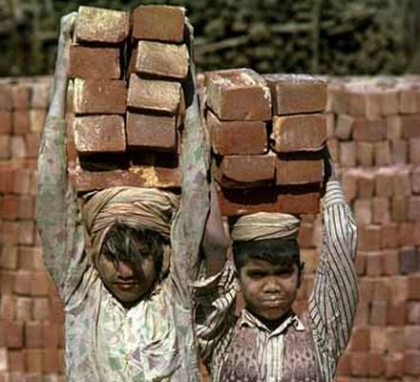
Right against exploitation

Slide 30
Right against exploitation
The abolition of trafficking in human beings and Begar (forced labour)
Abolition of employment of children below the age of 14 years in dangerous jobs like factories and mines.
Begar, practised in the past by landlords, has been declared a crime and is punishable by law
Trafficking in humans for the purpose of slave trade or prostitution is also prohibited by law.

Slide 31
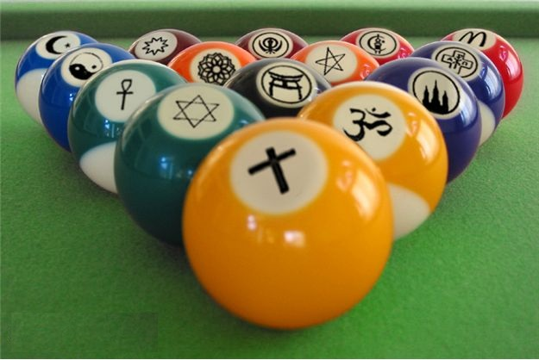
Right to freedom of religion

Slide 32
Right to freedom of religion
According to the Constitution, all religions are equal before the State and no religion shall be given preference over the other. Citizens are free to preach, practice and propagate any religion of their choice.
Religious communities can set up charitable institutions of their own.
Activities in such institutions which are not religious are performed according to the laws laid down by the government
No person shall be compelled to pay taxes for the promotion of a particular religion.
A State run institution cannot impart education that is pro-religion

Slide 33
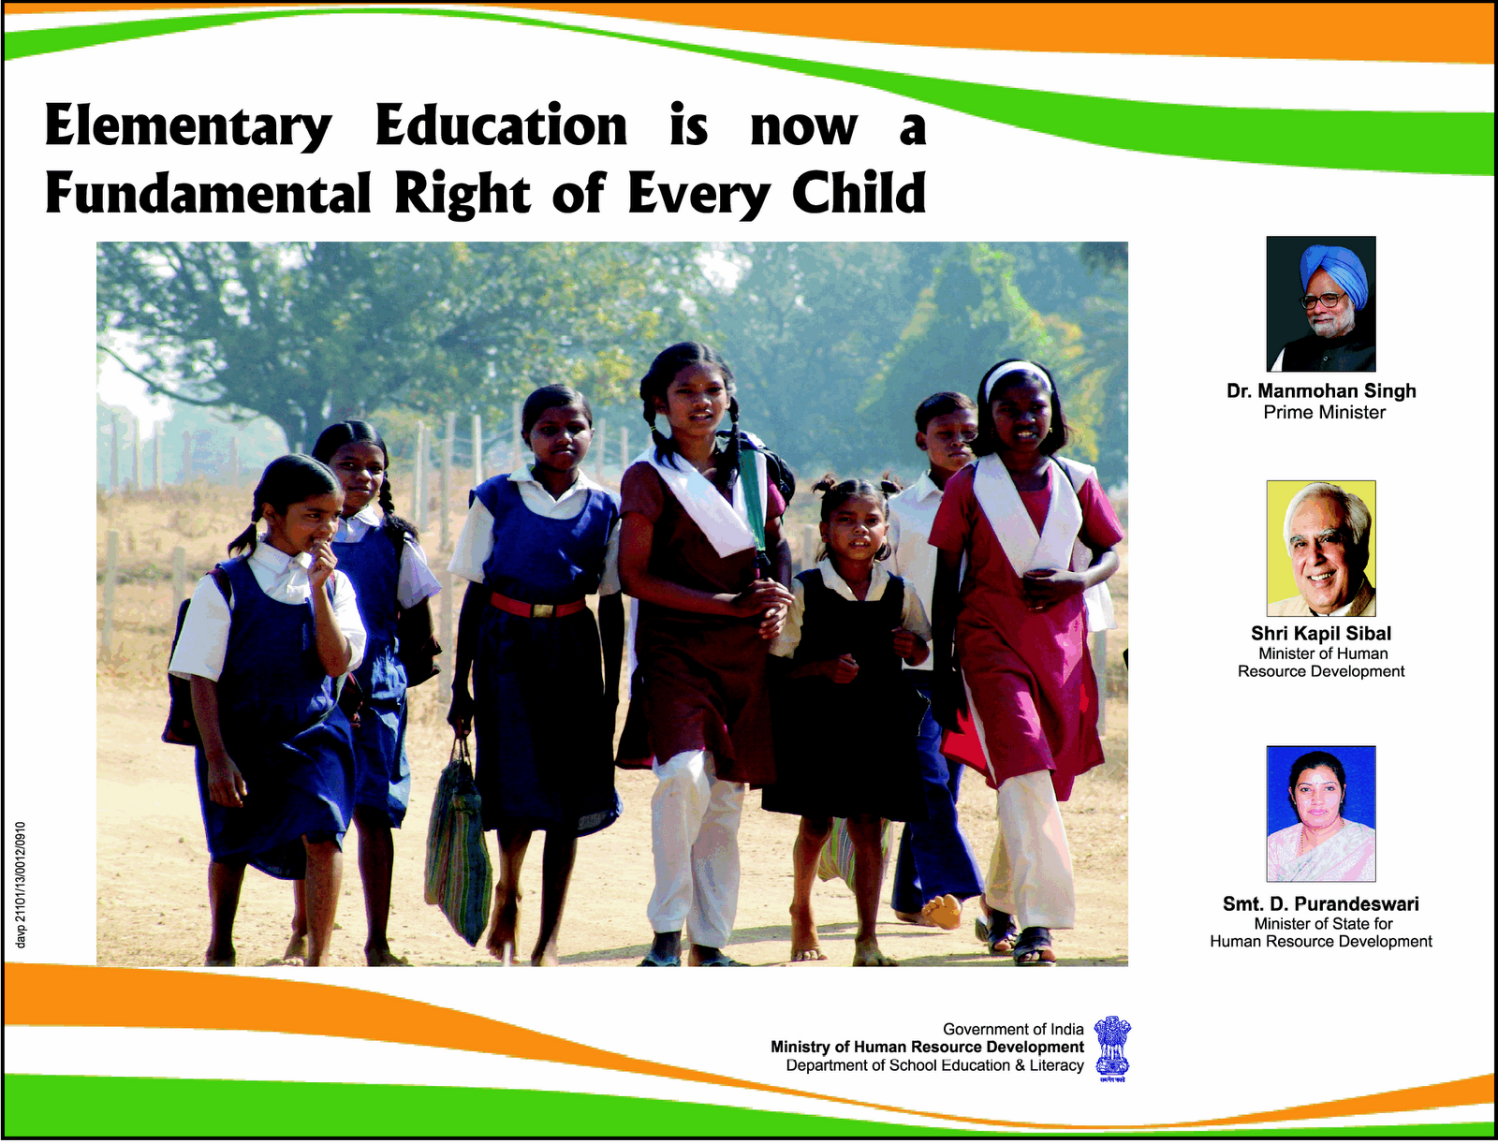
Cultural & educational Rights

Slide 34
Cultural & educational Rights
ARTICLES 29 & 30
Any community which has a language and a script of its own has the right to conserve and develop it.
All minorities, religious or linguistic, can set up their own educational institutions to preserve and develop their own culture.

Slide 35
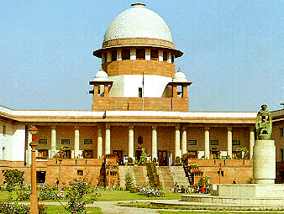
Right to constitutional remedies

Slide 36
Right to constitutional remedies5
Right to constitutional remedies empowers the citizens to move a court of law in case of any denial of the fundamental rights.
This procedure of asking the courts to preserve or safeguard the citizens' fundamental rights can be done in various ways. The courts can issue various kinds of writs. These writs are habeas corpus, mandamus, prohibition, quo warranto and certiorari.

Slide 37
RIGHT TO PROPERTY ,AN ORDINARY RIGHT
Till 1979 Right to Property was included in the list of Fundamental Rights. But through 44th amendment has been made an ordinary right and for this purpose Articls-300 A has been included into the constitution.

Slide 38
FIXED SIZE OF COUNCIL OF MINISTERS
Under this amendment the size of council of ministers of both Center and States has been fixed and now it cannot be more than 15% of the total strength of the lower house of Parliament in Center and States legislatures in the states. In case the strength of the Legislative Assembly in a State is 60 or less than that, then the maximum number of the ministers will be 12 which will include the Chief Minister.

Slide 39
RIGID AS WELL AS
FLEXIBLE CONSTITUTION
Indian constitution is neither rigid as the constitution of U.S.A nor flexible as the constitution of Great Britain.
Under Article-368 of the constitution,
Some of the articles of the constitution can be amended by the union parliament by passing a resolution with 2/3rd majority of the members present and voting and absolute majority of the total members.
Some of the articles of the constitution can be amended by
the Union Parliament by passing resolution with 2/3rd majority of the members present and voting and absolute majority of the total members and approval of ½ State Legislatures.

Slide 40
FEDERAL IN FORM,
UNITARY IN SPIRIT
The Constitution of India provides for
<<CENTRALISED FEDERALISM>>. There is no
doubt that federal system has been adopted in India, but keeping in mind certain special situations, the center is made more powerful or strong. Federal features :
Written Constitution
Rigid constitution
Supremacy of the constitution
Division of subjects
Independent judiciary etc.

Slide 41
UNIVERSAL ADULT
FRANCHISE
Article-326 provides for universal adult franchise and evry citizen including both male and female who is 18 years of age is given the right to vote without making any discrimination on the basis of sex, caste, colour religion etc.

Slide 42
SECULAR STATE
Every person has | the right | to practise, | profess,
propagate his/her | religion | according to | his/her
goodwill. The religious dominations have the right to establish and maintain institutions for religious and charitable purposes; to manage its own affairs in matters of religion; to own and acquire movable and immovable property and to administer such property in accordance with law. But no individual is allowed to misuse his or her religious freedom.
See in the case of “KESHVANAND BHARTI Vs.
STATE OF KERLA (A.I.R. 1973, S.C. 1461)

Slide 43
LIMITED POWERS OF THE PARLIAMENT
Indian Parliament is non-sovereign. There are limitations on the powers of the Parliament-
It can pass laws on those subjects which have been entrusted to it by the constitution.
The bills passed by the Parliament need the approval of the President.
The supreme court can exercise the powers of judicial review over the laws passed by the parliament and can declare unconstitutional the laws which it considers are against the constitution.

Slide 44
SINGLE-INTEGRATED
JUDICIAL SYSTEM
The entire judicial system of India is organized into an hierarchical order. Supreme Court is at the top of judicial administration below that there are high courts at the state level and there are district courts at the district level. All the courts of India are bound to accept the decisions of the supreme court.
See Ar. 137.

Slide 45
INDEPENDENT JUDICIARY
The constitution of India makes provisions for the independence of judiciary because only independent judiciary can safeguard the rights and liberties of the people, can protect the supremacy of the constitution-
An impartial method has been adopted for
the appointment of the judges
High qualifications have been fixed for the judges
The judges of the Supreme Court stay in office till 65 years of age and of High courts till 62 years of age

Slide 46
RULE OF LAW
The Rule of Law means that the law is supreme over person and everybody is equally responsible before law howsoever he/she may be. Also the man is punished on the violation of law and no arbitrary punishment can be given to him.

Slide 47
SINGLE CITIZENSHIP
There is provision of single citizenship in India. A person may be living in any state, but he is the citizen of India alone. The principle of double citizenship promotes regionalism and provincialism whereas the principle of single citizenship promotes national unity, therefore the principle of single citizenship is adopted in India.

Slide 48
JOINT ELECTORAL SYSTEM
The principle of
Joint
Electoral
System was
adopted after independence. Under Article- 325
of the
constitution it is said
that for every
constituency there will be one general electoral roll which will be one general electoral roll which will include the names of all the voters belonging to different classes , religions, sex and races etc., and they will elect a common representative.

Slide 49
SPECIAL PROVISIONS
The 68th Constitutional amendment made in 1990; it was provided for the appointment of the National Commission for the scheduled castes for the protection of their interests. In 2002, the government constituted two separate commissions for scheduled castes and scheduled tribes.

Slide 50

DIRECTIVE PRINCIPLES OF
STATE POLICY
Notes:
.

Slide 51
DIRECTIVE PRINCIPLES OF STATE POLICY
The Directive Principles of State Policy are the guidelines or principles given to the central and state governments of India to be kept in mind while framing laws and policies
The principles have been inspired by the Directive Principles given in the Constitution of Ireland relate to social justice, economic welfare, foreign policy, and legal and administrative matters.

Slide 52
CHARACTERISTICS
DPSPs aim to create social and economic conditions under which the citizens can lead a good life
They also aim to establish social and economic democracy through a welfare state
yardstick in the hands of the people to measure the performance of the government

Slide 53
Article 36 {Definition}
"the State" has the same meaning as in Part III.
Article 37 {Application of the principles contained in this Part}
The provisions contained in this Part shall not be enforced by any court, but the principles therein laid down are nevertheless fundamental in the governance of the country and it shall be the duty of the State to apply these principles in making laws.

Slide 54
Article 38 {State to secure a social order for the promotion of welfare of the people}
The State shall strive to promote the welfare of the people by securing and protecting as effectively as it may a social order in which justice, social, economic and political, shall inform all the institutions of the national life.
The State shall, in particular, strive to minimize the inequalities in income, and endeavour to eliminate inequalities in status, facilities and opportunities, not only amongst individuals but also amongst groups of people residing in different areas or engaged in different vocations.

Slide 55
ARTICLE 39 {CERTAIN PRINCIPLES OF POLICY TO BE FOLLOWED BY THE STATE}
The State shall, in particular, direct its policy towards securing -
that the citizen, men and women equally, have the right to an adequate means of livelihood;
that the ownership and control of the material resources of the community are so distributed as best to sub serve the common good;
that the operation of the economic system does not result in the concentration of wealth and means of production to the common detriment;

Slide 56
that there is equal pay for equal work for both men and women;
that the health and strength of workers, men and women, and the tender age of children are not abused and that citizens are not forced by economic necessity to enter avocations unsuited to their age or strength;
that children are given opportunities and facilities to develop in a healthy manner and in conditions of freedom and dignity and that childhood and youth are protected against exploitation and against moral and material abandonment.

Slide 57
Article 39A {Equal justice and free legal aid}
The State shall secure that the operation of the legal system promotes justice, on a basis of equal opportunity, and shall, in particular, provide free legal aid, by suitable legislation or schemes or in any other way, to ensure that opportunities for securing justice are not denied to any citizen by reason of economic or other disabilities.
Article 40 {Organization of village panchayats}
The State shall take steps to organise village panchayats and endow them with such powers and authority as may be necessary to enable them to function as units of self-government.

Slide 58
Article 41 {Right to work, to education and to public assistance in certain cases}
The State shall, within the limits of its economic capacity and development, make effective provision for securing the right to work, to education and to public assistance in cases of unemployment, old age, sickness and disablement, and in other cases of undeserved want.
Article 42 {Provision for just and human conditions of work and maternity relief}
The State shall make provision for securing just and humane conditions of work and for maternity relief...

Slide 59
Article 43 {Living wage, etc., for workers}
The State shall endeavor to secure, by suitable legislation or economic organisation or in any other way, to all workers agricultural, industrial or otherwise, work, a living wage, conditions of work ensuring a decent standard of life and full enjoyment of leisure and social and cultural opportunities and, in particular, the State shall endeavor to promote cottage industries on an individual or co-operative basis in rural areas.

Slide 60
Article 43A {Participation of workers in management of industries}
The State shall take steps, by suitable legislation or in any other way, to secure the participation of workers in the management of undertakings, establishments or other organization engaged in any industry. Provision mentioned in this part is not enforceable by Court orders

Slide 61
Article 44 {Uniform civil code for the citizen}
The State shall endeavor to secure for the citizens a Uniform Civil Code throughout the territory of India.
Article 45 {Provision for early childhood care and education to children below the age of six years}
The State shall endeavor to Provide early childhood care and education for all children untill they complete the age of six years.

Slide 62
Article 46 {Promotion of educational and economic interests of Scheduled Castes, Scheduled Tribes and other weaker sections}
The State shall promote with special care the educational and economic interests of the weaker sections of the people, and in particular, of the Scheduled Castes and the Scheduled Tribes, and shall protect them from social injustice and all forms of exploitation

Slide 63
Article 47 {Duty of the State to raise the level of nutrition and the standard of living and to improve public health}
The State shall regard the raising of the level of nutrition and the standard of living of its people and the improvement of public health as among its primary duties and, in particular, the State shall endeavour to bring about prohibition of the consumption except for medicinal purpose of intoxicating drinks and of drugs which are injurious to health.

Slide 64
Article 48 {Organisation of agriculture and animal husbandry}
The State shall endeavour to organise agriculture and animal husbandry on modern and scientific lines and shall, in particular, take steps for preserving and improving the breeds, and prohibiting the slaughter(kill), of cows and calves and other milch and draught cattle.

Slide 65
Article 48A {Protection and improvement of environment and safeguarding of forests and wild life}
The State shall endeavour to protect and improve the environment and to safeguard the forests and wild life of the country.
Article 49 {Protection of monuments and places and objects of national importance}
It shall be the obligation of the State to protect every monument or place or object of artistic or historic interest, declared by or under law made by Parliament to be of national importance, from spoliation, disfigurement, destruction, removal, disposal or export, as the case may be.

Slide 66
Article 50 {Separation of judiciary from executive}
The State shall take steps to separate the judiciary from the executive in the public services of the State.
Judiciary is the adjudicating body.
Judiciary has the power to review any law passed by the Parliament and can declare a law null and void if it violates the constitution.
Prime Minister along with his council of ministers is called the Temporary Executives. They implement the policies framed by the legislature.
Civil servants and other officers, staffs working under the government of India is called the Permanent Executives.

Slide 67
Article 51 {Promotion of international peace and security}
The State shall endeavour to -
promote international peace and security;
maintain just and honourable relations between nations;
foster respect for international law and treaty obligations in the dealings of organised people with one another; and
encourage settlement of international disputes by arbitration.

Slide 68
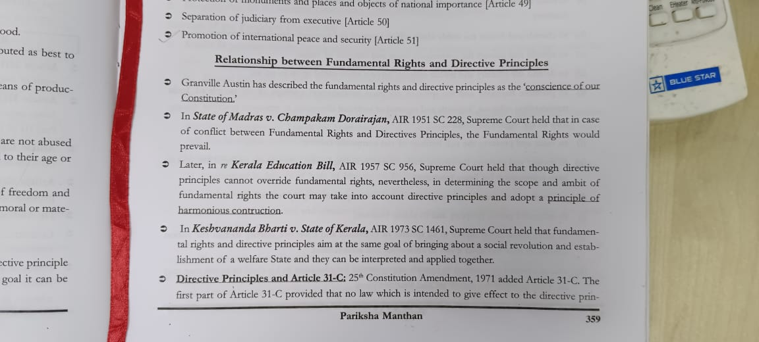

Slide 69
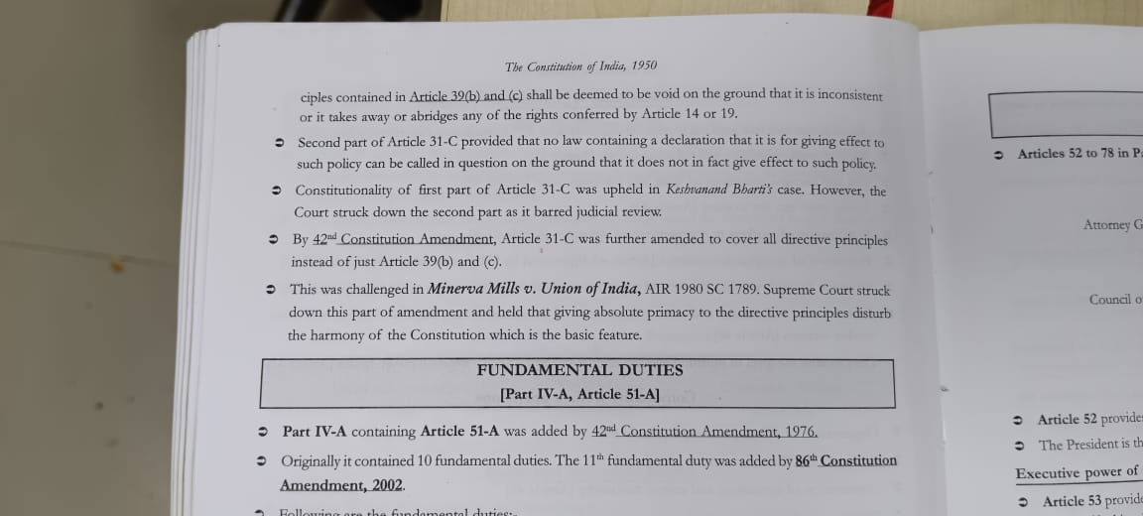

Slide 70
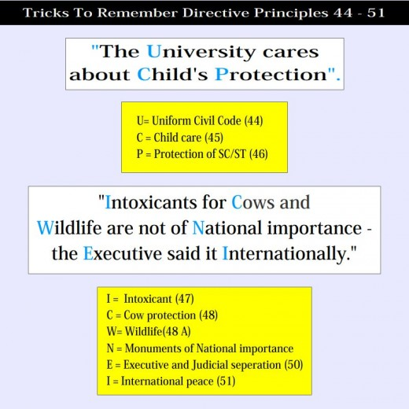

Slide 71
Amendments
42nd Amendment (1976) made four changes in DPSPs; Article 39, 39A, 43A, 48A.
44th Amendment (1978)-article 38
86th Amendment (2002)-article 21A
97th Amendment (2011)-article 43B

Slide 72
Criticism
Not Enforceable: Lack of legal force behind them is the main ground of criticism.
Illogically arranged: They are neither properly arranged nor logically classified.
Neither Practicable nor Sound: Their practicability and soundness also has been challenged by some critics.
Constitutional Conflict: Principles may lead to a conflict between the President of India and the Prime Minister on the one hand and between the Governor and the State Chief Minister on the other hand.

Slide 73
Difference between fundamental rights and DPSPs

Slide 74
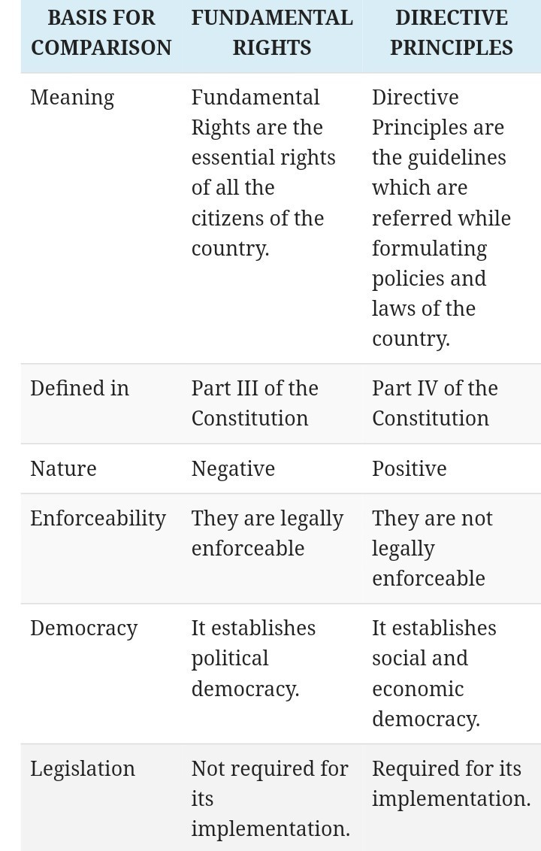

Slide 75

Fundamental DUTIES
OF
INDIAN CITIZEN

Slide 76
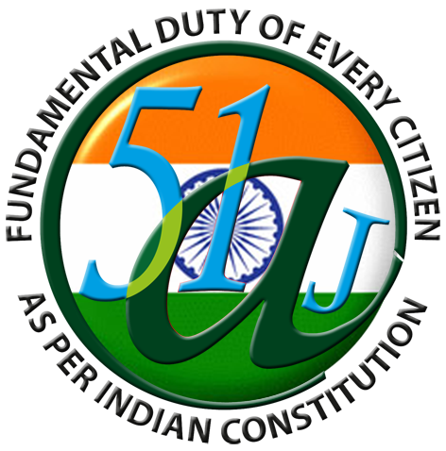
What are fundamental Duties?
Fundamental duties are defined as the moral obligations of all citizens to help promote a spirit of patriotism and to uphold the unity of India.
These duties set in part IV-A of the Constitution.
They are held by the Supreme Court to be obligatory for all citizens.

Slide 77
What are fundamental Duties?
The fundamental duties were included in the constitution by the 42nd amendment act 1976.
It incorporated the fundamental duties by inserting a new article 51A below article 51 which belongs to Part IV-A.
The recommendations were passed in 1976 and came into effect on 3rd January, 1977.

Slide 78
What are fundamental Duties?
Originally ten in number, the Fundamental Duties were increased to eleven by the 86th Amendment in 2002.
These duties were meant to bring our Constitution in line with the Universal Declaration of Human Rights and the Constitutions of Japan, China, and USSR.
It was adopted based on the recommendations of the SWARAN SINGH Committee.

Slide 79

The Duties
The fundamental duties of every citizen of India according to the Constitution are:
1.To abide by the Constitution and respect its ideals and institutions, the National Flag and the National Anthem;
2.To cherish and follow the noble ideals which inspired our national struggle for freedom;

Slide 80
The Duties
3. To uphold and protect the sovereignty, unity and integrity of India;
4. To defend the country and render national service when called upon to do so;
5. To promote harmony and the spirit of common brotherhood amongst all the people of India transcending religious, linguistic and regional or sectional diversities; to renounce practices derogatory to the dignity of women;

Slide 81
The Duties
6. to value and preserve the rich heritage of our composite culture;
7. to protect and improve the natural environment including forests, lakes, rivers and wild life, and to have compassion for living creatures;
8. to develop the scientific temper, humanism and the spirit of inquiry and reform;

Slide 82
The Duties
9. To safeguard public property and to abjure violence;
10. To strive towards excellence in all spheres of individual and collective activity so that the nation constantly rises to higher levels of endeavor and achievement;
11. Who is a parent or guardian to provide opportunities for education to his child or, as the case may be, ward between the age of six and fourteen years

Slide 83

Importance
Environmental pollution has become a great cause of concern. These duties remind us to keep our environment free from pollutants.
The inclusion of providing opportunity for education for children as a fundamental duty is a big step forward towards safeguard of human-rights and abolition of social injustices

Slide 84

Utility and Significance
The section ‘Fundamental Duties' was not a part of the original constitution.
These were added to the Constitution much later.
The idea behind incorporation of fundamental duties was to remind the citizens of the country that they have certain obligations towards the country and society.

Slide 85
Utility and Significance
The three most important items in the list of Fundamental Duties are:
1. those requiring the citizens to respect the ideals of the Constitution and the institutions it establishes,
2. to promote harmony and the spirit of common brotherhood amongst all the people of India professing different religions, speaking different languages and
3. to safeguard the public property and to abjure violence.

Slide 86
Non-enforceable and non-justiciable nature
This means that no one can be punished in case of their violation or non-compliance of any fundamental duty.
Similarly these duties are non-enforceable in nature.
That is no court can or any government body can directly enforce any of these duties on any particular citizen legally.

Slide 87

Non-enforceable and non-justiciable nature
But if the State makes a law to prohibit any act or conduct in violation of any of the duties, the courts would uphold that as a reasonable restriction on the relevant fundamental right.
For instance, a person who burns our national flag, in violation of the duty in Art. 51 A, cannot assert that it was burnt by way of demonstration against the Government should be protected by the freedom of expression right.

Slide 88
Constitution of India
Ms. Khushbu Prasad
Assistant Professor, Amity Law School, Amity University Patna

Slide 89
The Constitution of India was framed by Drafting Committee under the chairmanship of Dr. B. R. Ambedkar.
The Constitution was adopted by the Constituent Assembly an Nov. 26, 1949
The Constitution came into force from Jan. 26, 1950

Slide 90
The Constitution of India originally contained EIGHT (8) SCHEDULES; and
395 ARTICLES
Today the Constitution of India has
  Twelve (12) SCHEDULES; and
  444 ARTICLES

Slide 91
Major Parts of the Constitution
The four major parts of the Constitution of India are:
The Preamble
Parts I to XXII having 395 Articles
Twelve Schedules
Appendix

Slide 92
The Fundamental Rights
The six Fundamental Rights of Indian citizens as declared in the Constitution of India are:
Right to Equality
Right to Freedom
Right against Exploitation
Cultural and Educational Rights
Right to Freedom of Religion
Right to Constitutional Remedies
Initially there were seven fundamental rights but Right to Property was later converted into legal right by the 44th amendment of the Constitution in 1978

Slide 93
Directive Principles of State Policies
They come under the Part IV of the Constitution of India.
They are basically instruction to the Government to carry out certain responsibilities.
They are non-justifiable.

Slide 94
Structure of Union Government
President
    He is the constitutional Head of the State and the Supreme Commander of the armed forces.
    He is elected by an electoral college consisting of the elected members of the State Legislatures and both Houses of the Parliament.
    Tenure for the appointment is five years.
    He can’t be removed from the position except for non-constitutional conduct by impeachment under Article 61.
    He is responsible for the appointment of the Prime Minister, Chief Justice, Governors and other senior officials.

Slide 95
Vice- President
    He is elected by the electoral college consisting of the members of both Houses of the Parliament.
    Tenure is of the period of five years.
    He is also the Ex-Officio Member of the Rajya Sabha (Upper House of the Parliament).
    He is to act as the President in case of death, resignation, or when he is unable to discharge his duties due to any reason.
    There is as such no job responsibilities specified for the post of Vice – President in the Constitution of India

Slide 96
Prime Minister
Appointed by the President, he is the Head of the Council of Ministers and is the leader of the Party in majority in the Lok Sabha.
He is appointed for a period of five years

Slide 97
The Parliament
It consists of two houses:
The Upper House or The Rajya Sabha
The Lower House or the Lok Sabha

Slide 98
The Lok Sabha
Also known as Lower House
Consists of members directly elected by the people from the constituencies in various states and Union Territories.
It consists of 552 members, out of which two seats are reserved for Anglo-Indian community which are to be nominated by the President.
The presiding officer is the Speaker who is elected by the members of the Lok Sabha.

Slide 99
The Rajya Sabha
Also known as the Upper House.
The chairperson is Vice-President of India who is ex-officio.
Rajya Sabha is permanent and cannot be dissolved in any condition.
There are total 250 members in the Rajya Sabha out of which 238 members come through elections from the States and Union Territories and 12 members are nominated by the President of India.
One third of the members of the Rajya Sabha retire every two years.

Slide 100
Both, the Lok Sabha and the Rajya Sabha are the grounds for debating, passing the bills, constitutional amendments and other issues pertaining to the welfare of the nation.

Slide 101
Bills
Bills can be said as the proposals that are debated over in the Parliament.
All the ordinary bills can be introduced in either of the two Houses of the Parliament.
They are, if needed, amended and passed by both the Houses, before becoming an Act of Law.
A special category of Bills called Money Bills can only be introduced in the Lok Sabha.

Slide 102
The Supreme Court of India
This is the apex judicial body in the country and is situated in Delhi.
It consists of 25 judges and a Chief Justice, who is appointed by the President of India.
The judges of the Supreme Court retires at the age of 65 and cannot be employed in any of the Government establishment, State or Union, after retirement.

Slide 103
The Supreme Court
The main functions of the Supreme Court of India includes solving disputes between the States and the Union Governments, hearing of appeals of various High Courts and any matter pertaining to the law in its opinion.

Slide 104
Other Important Officials
The Comptroller and Auditor General of India (CAG)
    He is appointed by the President of India.
    He is responsible for keeping a vigil over the finances of the State and Union Governments and make sure that the money allocated by the voting of the legislature is spent in a fair and judicious manner.

Slide 105
The Attorney General of India
He is appointed by the President of India
He can take part in the proceedings of the Parliament and its committees but do not have voting rights.
He is primarily responsible for giving expert legal advice to the Government of India and other legal tasks assigned to him.

Slide 106
Governor
He is the executive head of the State and is appointed by the President.
The tenure for the appointment is 5 yrs.
Major Functions are:
  He’s responsible for the appointment of Council of Ministers .
  He is responsible for causing the normal or supplementary budgets to be presented each year.
  He can also sanction funds out of contingency fund to the government to meet unexpected expenses of the state.
  He is responsible for giving the assent to the bills passed by the state legislation, without which they cannot become an Act of Law

Slide 107
Chief Minister
He’s the real executive of the State administration, and is the leader of the party which is in majority in the State Legislative Assembly, and is appointed by the Governor.
He recommends the name of persons for the council of ministers.
He formulates the administrative and executive policies of the state and presides over the meetings of the cabinet.

Slide 108
PUBLIC SERVICE COMMISSION
Ms. Khushbu Prasad
Assistant Professor, Amity Law School, Amity University Patna

Slide 109
INTRODUCTION
COMPOSITION/APPOINTMENTS
REMOVAL AND SUSPENSION
POWERS
PROHIBITIONS
FUNCTIONS
ADDITIONAL FUNCTIONS
EXPENSES
REPORTS

Slide 110

INTRODUCTION
* STATUTORY BODY – CONDUCTS EXAMINATIONS – THREE LEVELS
i) UPSC – UNION PUBLIC SERVICE COMMMISSION
ii) SPSC – STATE PUBLIC SERVICE COMMISSION
iii) JSPSC – JOINT STATE PUBLIC SERVICE COMMISSION
* DIRECTLY CREATED BY THE CONSTITUTION.
* ARTICLE 315 – 323 IN PART XIV OF CONSTITUTION – PROVISIONS.
* EXAMINATIONS HELD BY UPSC :-
1. Civil Services Examination
2. Indian Forest Service Examination
3. National Defence Academy Examination
4. Naval Academy Examination
5. Central Armed Police Forces (Assistant Commandant) Examination.

Slide 111
ARTICLE 315
* ESTABLISHMENT OF UPSC,SPSC AND JPSC.
UPSC – CENTRAL/ UNION
SPSC – STATE
JSPSC – TWO OR MORE STATES.
------------------------------------------------------
ARTICLE 316 : APPOINTMENTS/COMPOSITION AND TERM OF OFFICE
UPSC AND JSPSC – PRESIDENT
1) CHAIRMAN AND OTHER MEMBERS
SPSC FOR STATE – GOVERNOR
10 YEARS - GOVERNMENT OF INDIA OR GOVERNMENT OF STATE.
2) 6 YEARS - HOLD HIS OFFICE ; OR 65 YEARS UPSC ; 62 YEARS SPSC

Slide 112
2) (a) RESIGNATION - BY OWN HANDWRITTEN - UPSC & JSPSC – PRESIDENT
- SPSC – GOVERNOR OF STATE
2) (b) REMOVAL - REMOVAL OF MEMBER OF PUBLIC SERVICE COMMISSION
UNDER CLAUSE (1) OR (3) OF ARTICLE 317.
3) INELIGIBLE FOR REAPPOINTMENT
------------------------------------------------------
ARTICLE 317 – REMOVAL AND SUSPENSION OF MEMBER OF P.S.C
1) MISBEHAVIOUR - GROUND OF REMOVAL OF CHAIRMAN OR OTHER
MEMBER OF PUBLIC SERVICE COMMISSION
2) SUSPENSION - RECEIPT/ REPORT FROM SUPREME COURT – ORDER FROM
PRESIDENT.

Slide 113
3) REMOVAL NOTWITHSTANDING ANYTHING IN CLAUSE (1) CHAIRMAN OR ANY
MEMBER CAN BE REMOVED IF THE CASE :-
i) ADJUDGED AN INSOLVENT (BANKRUPT)
ii) DURING OFFICE TERM – ENGAGES IN OTHER PAID EMPLOYMENT
iii) UNFIT / INFIRMITY OF MIND OR BODY.
ARTICLE 318 : POWERS TO MAKE REGULATIONS TO CONDITIONS OF SERVICE OF MEMBERS AND STAFF OF COMMISSION.
a) REGULATIONS - TO DETERMINE NUMBER OF MEMBERS AND CONDITIONS
OF THE SERVICE IN COMMISSION.
b) PROVISIONS - WITH RESPECT TO MEMBERS AND THE CONDITIONS OF
SERVICE IN THE COMMISSION.

Slide 114
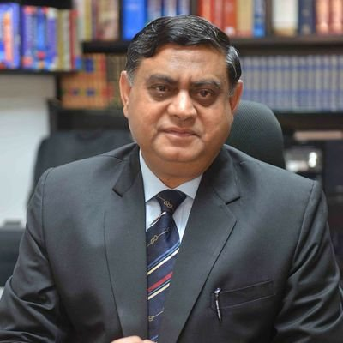
ARTICLE 319 : PROHITIONS AS TO HOLDINGS OF OFFICES BY MEMBERS OF COMMISSION ON CEASING TO BE MEMBERS
a) INELIGIBLE – FURTHER EMPLOYMENT IN GOVT. OF INDIA OR GOVT. OF STATE.
b) CHAIRMAN OF SPSC – ELIGIBLE – AS CHAIRMAN OR MEMBER FOR UPSC AND CHAIRMAN OF ANY OTHER SPSC.
c) MEMBER OTHER THAN CHAIRMAN – UPSC – ELIGIBLE – AS CHAIRMAN OF UPSC OR SPSC.
d) MEMBER OTHER THAN CHAIRMAN – SPSC – ELIGIBLE – AS CHAIRMAN OR ANY MEMBER OF UPSC OR CHAIRMAN OR ANY MEMBER OF SPSC.
DR. KRISHNA KUMAR KHANDELWAL
IAS RETD. Deputy Collector –Faridabad
1985 – 2018
AT PRESENT – CHIEF NATIONAL COMMISSIONER
BHARAT SCOUTS AND GUIDES, INDIA

Slide 115
ARTICLE 320 : FUNCTIONS OF PUBLIC SERVICE COMMISSION
DUTY OF UPSC, SPSC, JSPSC - CONDUCTING OF EXAMINATIONS FOR THE APPOINTMENTS TO SERVICES OF UNION AND STATES.
JSPSC – REQUEST TO ASSIST – FRAMING AND OPERATING SCHEMES – SPECIAL QUALIFICATIONS OF CANDIDATES.
DUTY OF UPSC – ADVICES PRESIDENT – METHODS OF RECRUITMENT.
PRINCIPLES – APPOINTMENTS , PROMOTIONS AND TRANSFERS.
DISCIPLINARY MATTERS – PERSON - UNDER GOVT. OF INDIA OR GOVR. OF STATE.
ARTICLE 321 : ADDITIONAL FUNCTIONS
BY ACT OF PARLIAMENT – LEGISTURE – ADDITIONAL POWERS – EXCERCISED – WITH RESPECT TO SERVICES OF UNION , STATE, LOCAL AUTHORITY.

Slide 116
ARTICLE 322 : EXPENSES OF PUBLIC SERVICE COMMISSION
EXPENSES OF UPSC OR SPSC – SALARIES, PENSIONS – PAYABLE TO MEMBERS OR STAFF OF COMMISSION – CHARGED – CONSOLIDATED FUND – GOVERNMENT OF INDIA OR STATE.
ARTICLE 323 : REPORTS OF PUBLIC SERVICE COMMISSION
* ANNUAL REPORT OF WORK DONE – COMMISSION – PRESIDENT – COPY – MEMORANDUM EXPLANATION – NO ACCEPTANCE OF UPSC ADVICE.

Slide 117
Conclusion
And for the enjoyment of valuable fundamental rights, firstly we need to obey our fundamental duties seriously, as a law-abiding citizen, and must realise that he has certain duties towards the Nation to achieve the objective of Part IV-A that is National integrity and respect because as Salmond said,
“there can be no right, without a corresponding duty.”

Slide 118


Slide 119



